Slide 1

CHAPTER 6
SET THEORY
Copyright © Cengage Learning. All rights reserved.

Slide 2

6.2
Properties of Sets
Copyright © Cengage Learning. All rights reserved.

Slide 3
Properties of Sets
It is possible to list many relations involving unions, intersections, complements, and differences of sets. Some of these are true for all sets, whereas others fail to hold in some cases.
In this section we show how to establish basic set properties using element arguments, and we discuss a variation used to prove that a set is empty.
We begin by listing some set properties that involve subset relations.

Slide 4
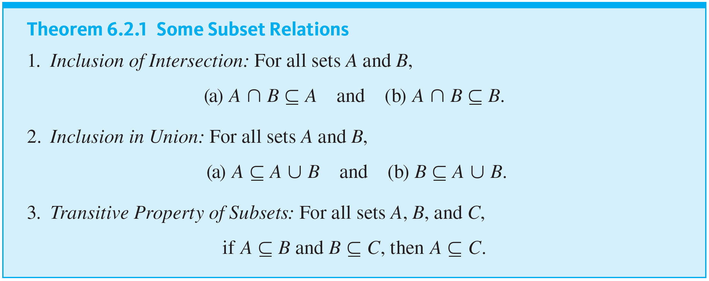
Properties of Sets
As you read them, keep in mind that the operations of union, intersection, and difference take precedence over set inclusion. Thus, for example, A ∩ B ⊆ C means
(A ∩ B) ⊆ C.

Slide 5
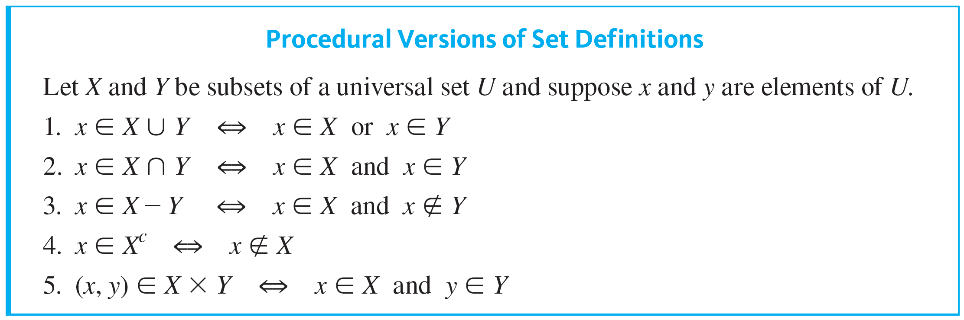
Properties of Sets
Procedural versions of the definitions of the other set operations are derived similarly and are summarized below.

Slide 6
Proving a Subset Relation

Slide 7
Proving a Subset Relation
Consider trying to prove Theorem 6.2.1(a): For all sets A and B, A ∩ B ⊆ A. First notice that the statement is universal. It makes a claim about all sets A and B. So the proof has the following outline:
Starting Point: Suppose A and B are any [particular but arbitrarily chosen] sets.
To Show: A ∩ B ⊆ A

Slide 8
Proving a Subset Relation
Now to prove A ∩ B ⊆ A you must use the definition of subset. In other words, you must show that
∀x, if x ∈ A ∩ B, then x ∈ A.
This statement is also universal, and to prove it you use an element argument:
suppose x is any element in A ∩ B
and
show that x is in A.

Slide 9
Proving a Subset Relation
You can fill in the gap between “suppose” and the “show” by using the procedural version of the definition of intersection along with your knowledge of logic and the definition of subset.

Slide 10
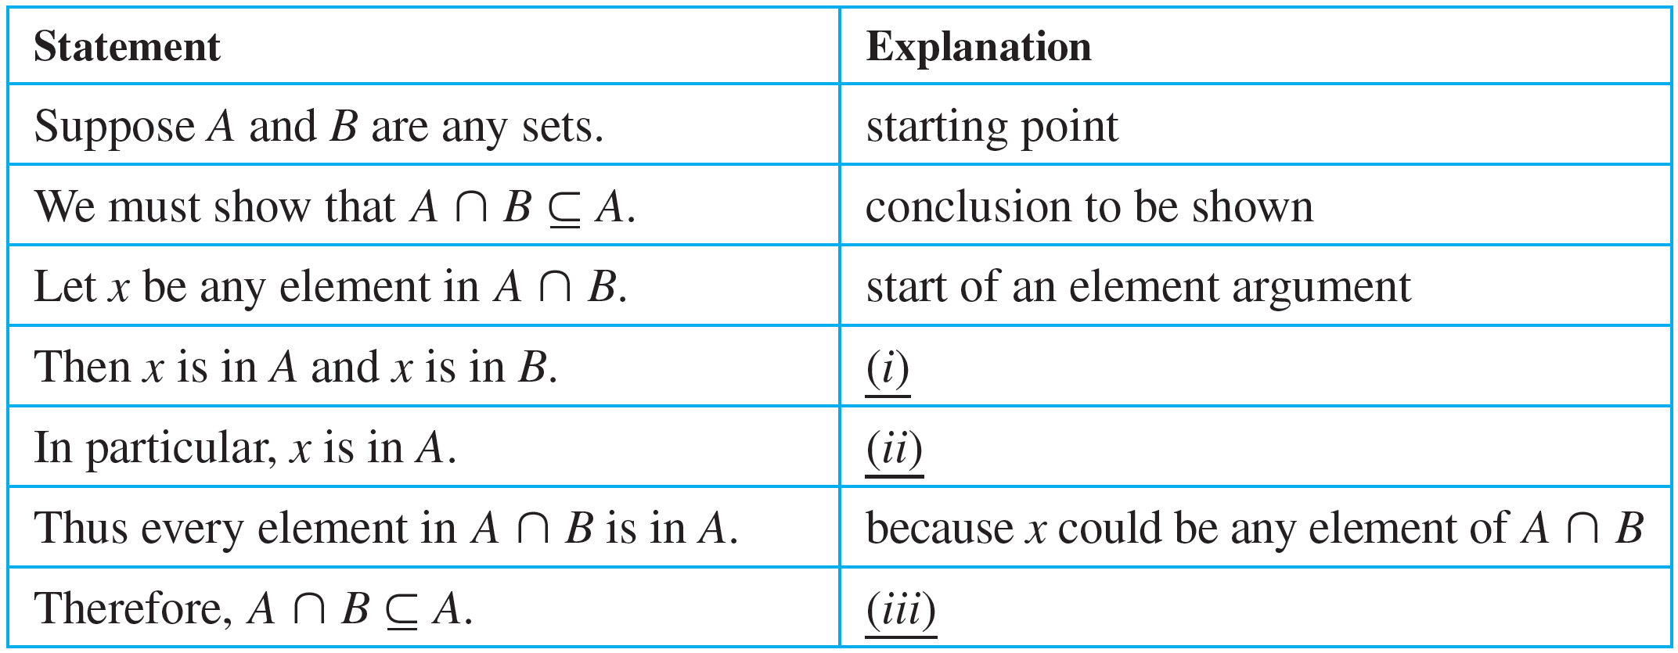
Example 6.2.1 – Fill in the Blanks for Proofs of Subset Relations
Fill in the blanks in the proofs shown below.
a. Theorem 6.2.1(1)(a): For all sets A and B, A ∩ B ⊆ A.
Proof:

Slide 11
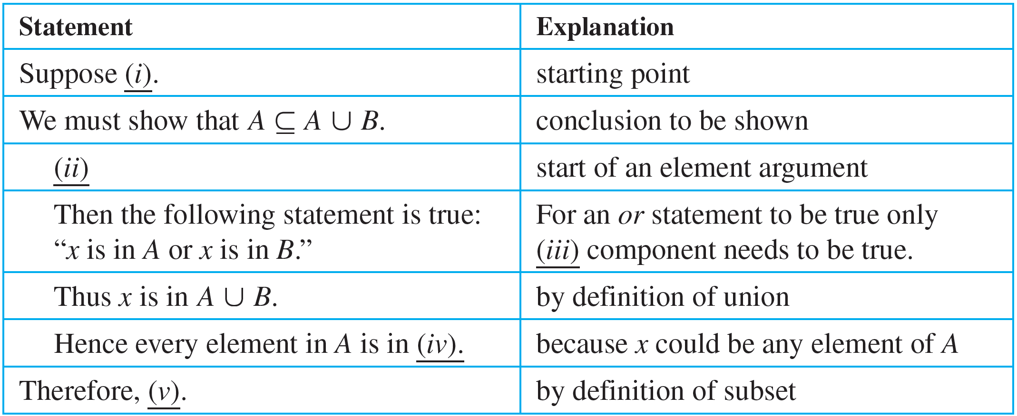
Example 6.2.1 – Fill in the Blanks for Proofs of Subset Relations
continued
b. Theorem 6.2.1(2)(a): For all sets A and B, A ⊆ A ⋃ B.
Proof:

Slide 12
Example 6.2.1 – Solution
a. (i) by definition of intersection (ⅱ) If an and statement is true, then each individual component is true (ⅲ) by definition of subset
b. (i) A and B are any sets. (ⅱ) Let x be any element in A. (Or: Suppose x is any element in A.) (ⅲ) one (ⅳ) A ⋃ B (ⅴ) A ⊆ A ⋃ B

Slide 13
Set Identities

Slide 14
Set Identities
An identity is an equation that is universally true for all elements in some set. For example, the equation a + b = b + a is an identity for real numbers because it is true for all real numbers a and b.
The collection of set properties in the next theorem consists entirely of set identities. That is, they are equations that are true for all sets in some universal set.

Slide 15
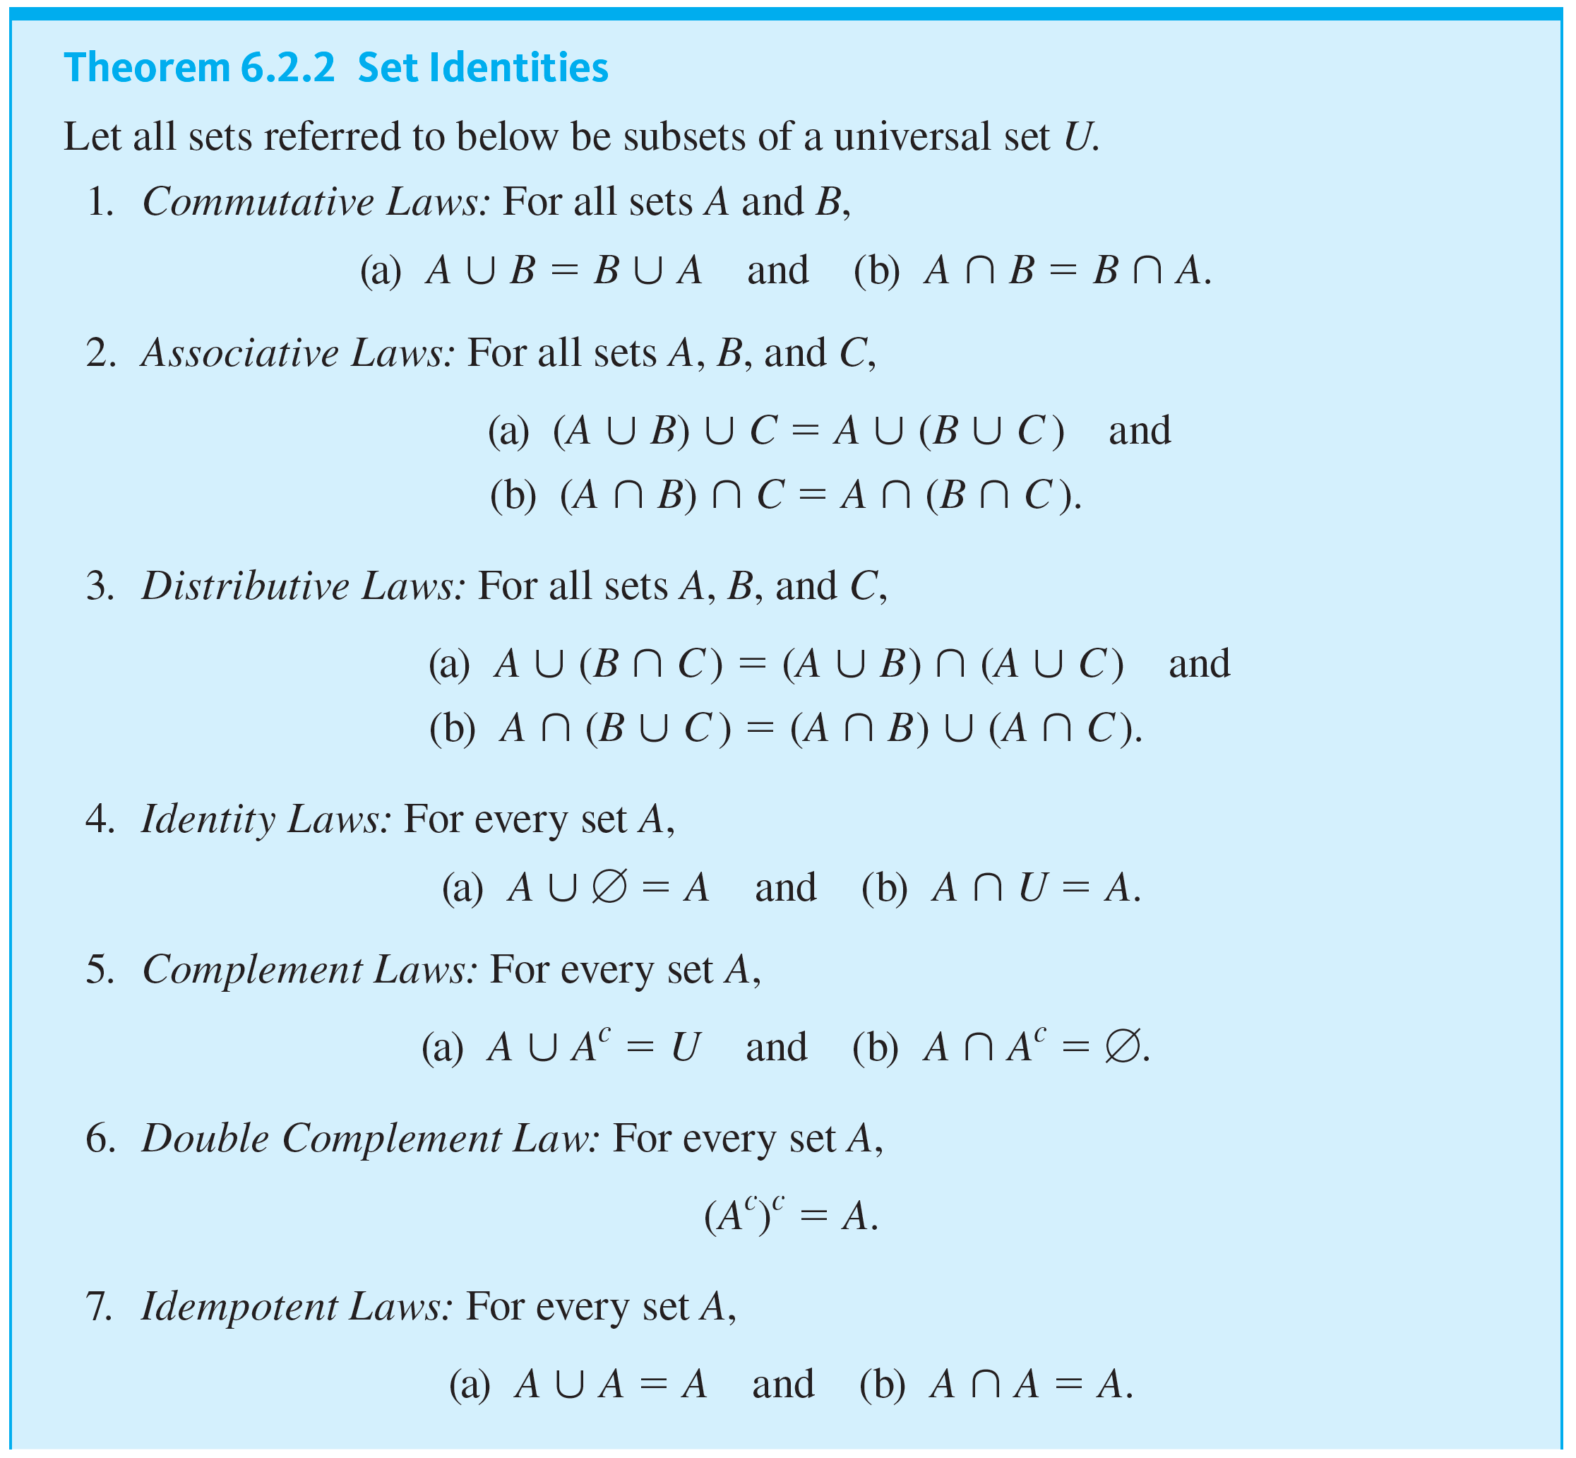
Set Identities

Slide 16
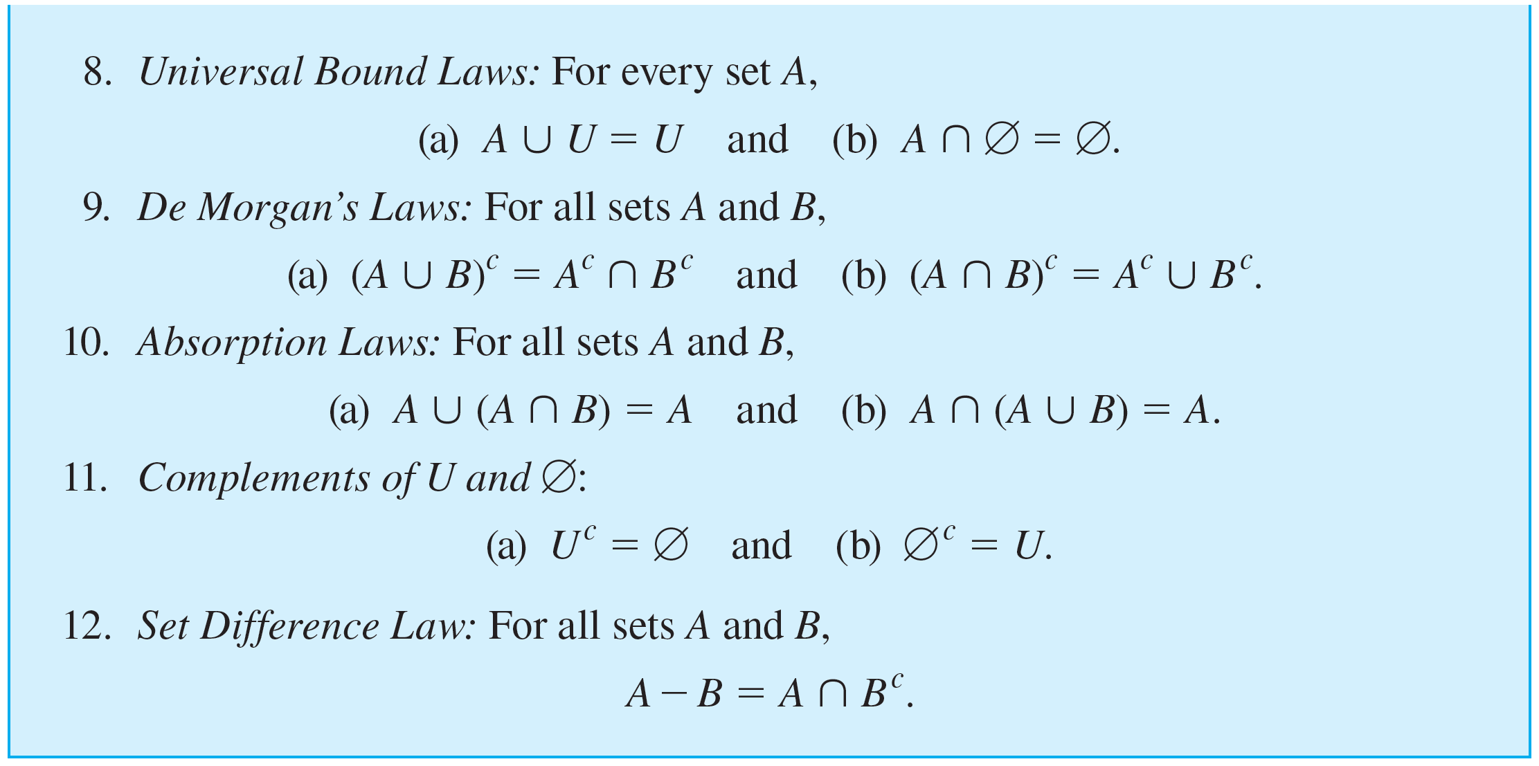
Set Identities
continued

Slide 17
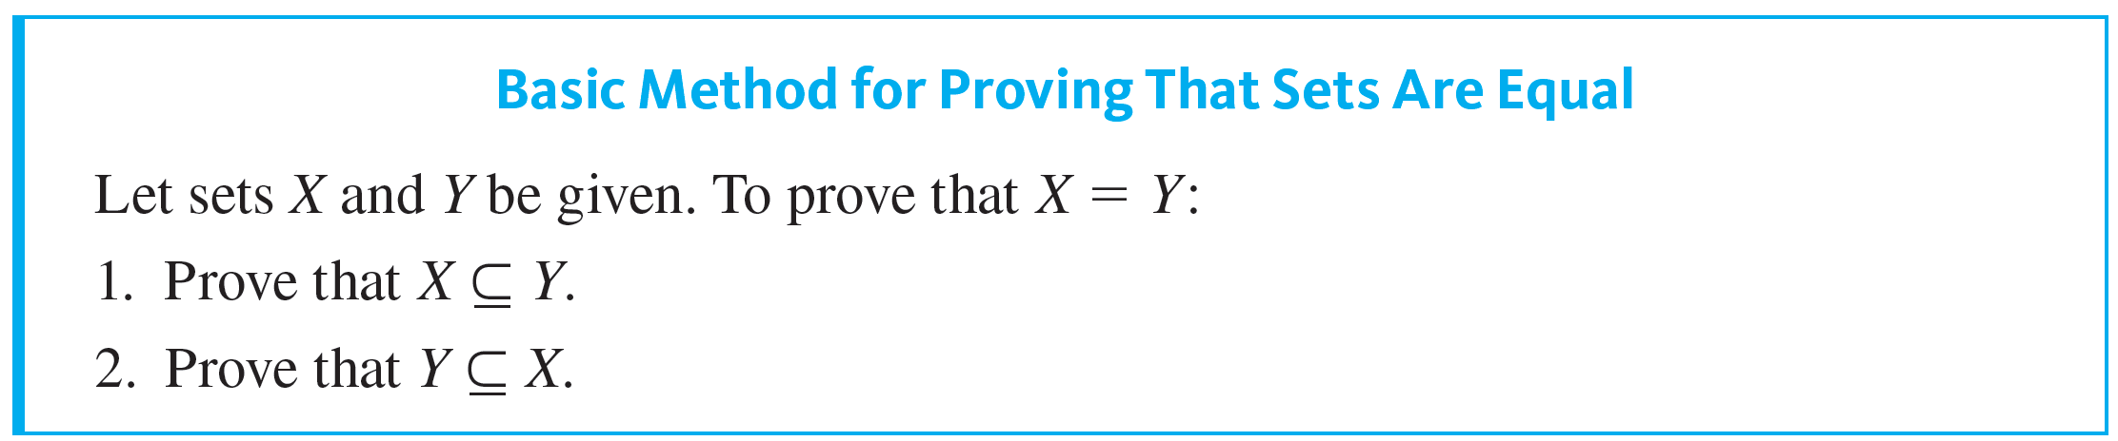
Set Identities

Slide 18
Example 6.2.2 – Proof of a Distributive Law
Consider trying to prove that for all sets A, B, and C,
A ⋃ (B ∩ C) = (A ⋃ B) ∩ (A ⋃ C).

Slide 19
Example 6.2.2 – Solution
The proof of this fact is somewhat more complicated than the proofs in Example 6.2.1, so we first derive its logical structure, then find the core arguments, and end with a formal proof as a summary.
As in the subset relation examples, the statement to be proved is universal.

Slide 20
Example 6.2.2 – Solution
continued
Thus, by the method of generalizing from the generic particular, the proof has the following outline:
Starting Point: Suppose A, B, and C are arbitrarily chosen sets.
To Show: A ∪ (B ∩ C) = (A ∪ B) ∩ (A ∪ C).

Slide 21
Example 6.2.2 – Solution
continued
Now two sets are equal if, and only if, each is a subset of the other.
Hence, the following two statements must be proved:
A ∪ (B ∩ C) ⊆ (A ∪ B) ∩ (A ∪ C)
and
(A ∪ B) ∩ (A ∪ C) ⊆ A ∪ (B ∩ C).

Slide 22
Example 6.2.2 – Solution
continued
Showing the first subset relation requires showing that
∀x, if x ∈ A ∪ (B ∩ C) then x ∈ (A ∪ B) ∩ (A ∪ C).
Showing the second containment requires showing that
∀x, if x ∈ (A ∪ B) ∩ (A ∪ C) then x ∈ A ∪ (B ∩ C).

Slide 23
Example 6.2.2 – Solution
continued
Note that both of these statements are universal. So to prove the first containment, you
suppose you have any element x in A ∪ (B ∩ C),
and then you
show that x ∈ (A ∪ B) ∩ (A ∪ C).
And to prove the second containment, you
suppose you have any element x in (A ∪ B) ∩ (A ∪ C),
and then you
show that x ∈ A ∪ (B ∩ C).

Slide 24
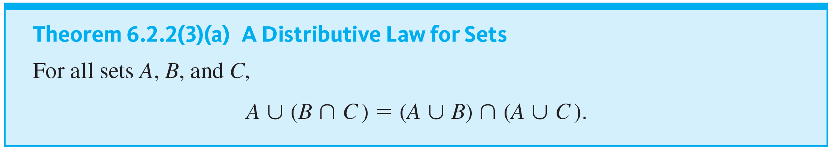
Example 6.2.2 – Solution
continued

Slide 25
Set Identities
In the study of artificial intelligence, the types of reasoning used previously to derive the proof of the distributive law are called forward chaining and backward chaining.
First what is to be shown is viewed as a goal to be reached starting from a certain initial position: the starting point.
Analysis of this goal leads to the realization that if a certain job is accomplished, then the goal will be reached.

Slide 26
Set Identities
Call this job subgoal 1: SG₁. (For instance, if the goal is to show that A ∪ (B ∩ C) = (A ∪ B) ∩ (A ∪ C), then SG₁ would be to show that each set is a subset of the other.) Analysis of SG₁ shows that when yet another job is completed, SG₁ will be reached.
Call this job subgoal 2: SG₂. Continuing in this way, a chain of argument leading backward from the goal is constructed.

Slide 27

Example 6.2.3 – Proof of a De Morgan’s Law for Sets
Prove that for all sets A and B,

Slide 28



Example 6.2.3 – Solution
As in previous examples, the statement to be proved is universal, and so the starting point of the proof and the conclusion to be shown are as follows:
Starting Point: Suppose A and B are arbitrarily chosen sets.
To Show:
To do this, you must prove both that
and that

Slide 29


Example 6.2.3 – Solution
continued
To prove the first subset relation means to show that
And to prove the second subset relation means to show that
Since each of these statements is universal and conditional, for the first subset relation, you
and then you

Slide 30


Example 6.2.3 – Solution
continued
And for the second subset relation, you
and then you
To fill in the steps of these arguments, you use the procedural versions of the definitions of complement, union, and intersection, and at crucial points you use De Morgan’s laws of logic.

Slide 31
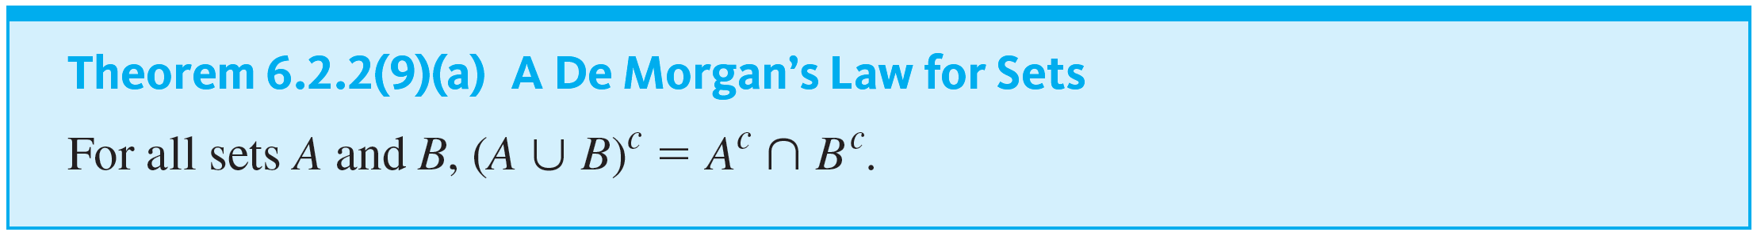
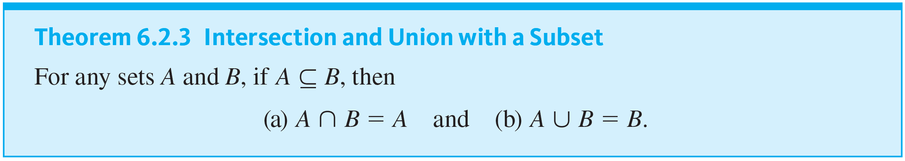
Example 6.2.3 – Solution
continued

Slide 32
The Empty Set

Slide 33
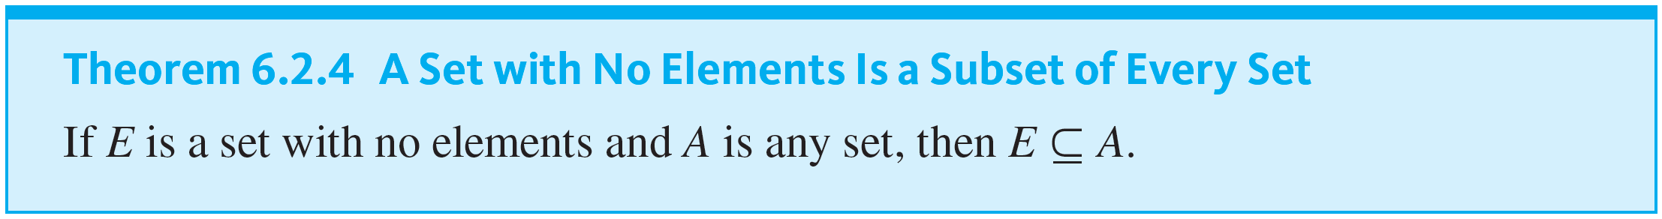
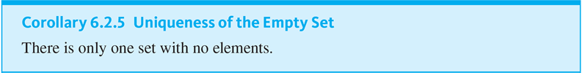
The Empty Set

Slide 34

Example 6.2.4 – Proving That a Set Is Empty
Prove that for any set A,

Slide 35



Example 6.2.4 – Solution
Let A be a [particular, but arbitrarily chosen] set. To show that
it suffices to show that
has no elements [by the element method for proving a set equals the empty set].
Suppose not. That is, suppose there is at least one element—say x—such that
Then, by definition of intersection,

Slide 36


Example 6.2.4 – Solution
continued
In particular,
has no elements. [This contradiction shows that the supposition that there is an element x in
But this is impossible since
has no elements, as was to be shown.] Thus
is false. So

Slide 37


Example 6.2.5 – A Proof for a Conditional Statement
Prove that for all sets A, B, and C, if
then

Slide 38


Example 6.2.5 – Solution
Because the statement to be proved is both universal and conditional, you start with the method of direct proof:
Suppose A, B, and C are arbitrarily chosen sets that
satisfy the condition:
Show that
Since the conclusion to be shown is that a certain set is empty, you can use the principle for proving that a set equals the empty set.

Slide 39
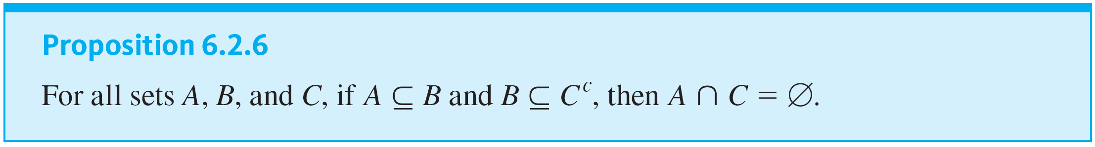
Example 6.2.5 – Solution
continued

Slide 40
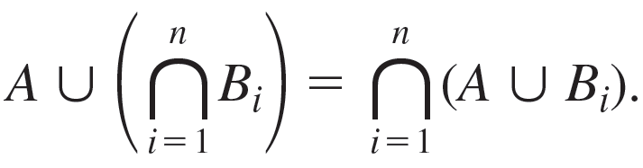
Example 6.2.6 – A Generalized Distributive Law
Prove that for all sets A and B₁, B₂, B₃, . . . , B _{n}, where n is a positive integer,

Slide 41
Example 6.2.6 – Solution
Compare this proof to the one given in Example 6.2.2. Although the notation is more complex, the basic ideas are the same.
Proof: Suppose A and B₁, B₂, B₃, . . . , B _{n} are any sets and n is a positive integer.

Slide 42

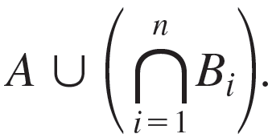
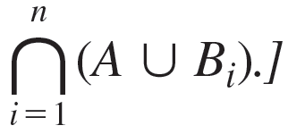
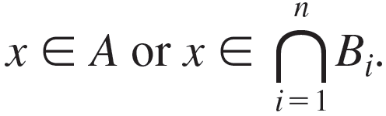
Example 6.2.6 – Solution
continued
Part 1, Proof that
[We must show
that x is in
Suppose x is any element in
By definition of union,

Slide 43
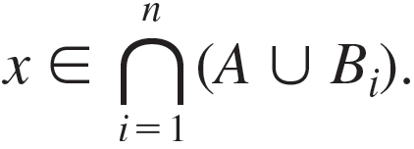
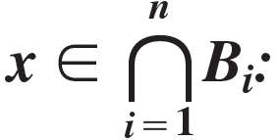
Example 6.2.6 – Solution
continued
Case 1, x ∈ A: In this case, it is true by definition of union that for every integer i = 1, 2, . . . , n, x ∈ A ∪ B _{i}.
Hence
In this case, by definition of the general
intersection, we have that for every integer
i = 1, 2, . . . , n, x ∈ B _{i}.
Case 2,

Slide 44
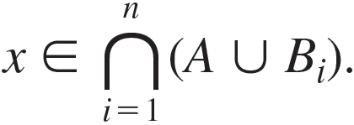
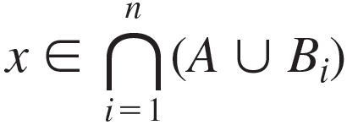
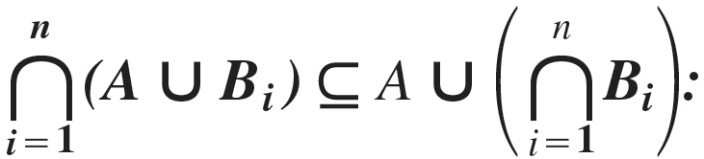
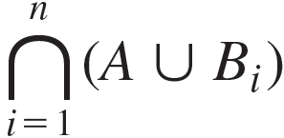
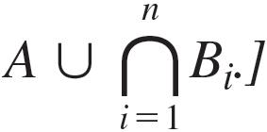
Example 6.2.6 – Solution
continued
Hence, by definition of union, for every integer i = 1, 2, . . . , n, x ∈ A ⋃ B _{i}, and so, by definition of general intersection,
Thus, in either case,
[as was to be shown].
Part 2, Proof that
Suppose x is any element in
[We must show that x is in

Slide 45
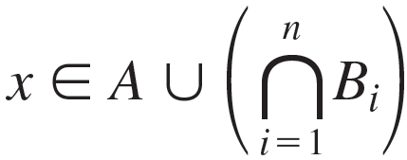
Example 6.2.6 – Solution
continued
By definition of intersection, x ∈ A ∪ B _{i} for every integer i = 1, 2, . . . , n. Either x ∈ A or x ∉ A.
Case 1, x ∈ A: In this case,
by definition of union.
Case 2, x ∉ A: By definition of intersection, x ∈ A ∪ B _{i} for every integer i = 1, 2, . . . , n.
Since x ∉ A, x must be in each B_{i} for every integer i = 1, 2, . . . , n.

Slide 46
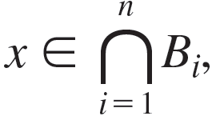
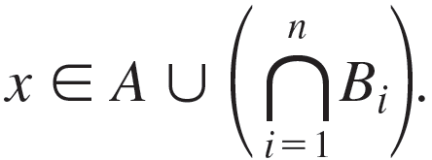
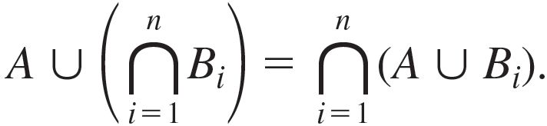
Example 6.2.6 – Solution
continued
Hence, by definition of intersection,
and so, by
definition of union,
Conclusion: Since both set containments have been proved, it follows by definition of set equality that

